Slide 1
LIN6209 Coding for Linguists
Data Visualisation
Pandas, Numpy, MatPlotLib & Seaborn

Slide 2
Last week – Jupyter Notebooks
What a Jupyter notebook is and why it is useful
How to create a Jupyter notebook
How to use a Jupyter notebook
Jupyter notebook set-up
Client
Server
Jupyter use cases:
Software design
Data analysis
Presentation of results
Static presentation
Dynamic presentation
Collaborative working
‘Anywhere & Anytime’

Slide 3
design
build
test
evaluate
analyse
requirements

Slide 4
This Week – Data Visualization
Line graphs
Bar charts
Histograms
Scatter plots
Pie charts
Contour maps
Pseudo-colour images
Some background on:
Panda
Numpy
Matplotlib
Seaborn
These packages have a large number of methods, often with an equally large number of options
So . . . Keep Things SIMPLE

Slide 5
Getting started
The tools needed and drawing a few simple plots

Slide 6
Python Libraries
Panda
Panel Data
Getting your data into Python, cleaning it up and making it ready for processing
Numpy
Numerical python
Optimised for fast and efficient calculations on large amounts of data
Matplotlib
Is not primarily about maths!
Plotting data on charts
Seaborn
Even more plotting
Based on matplotlib

Slide 7
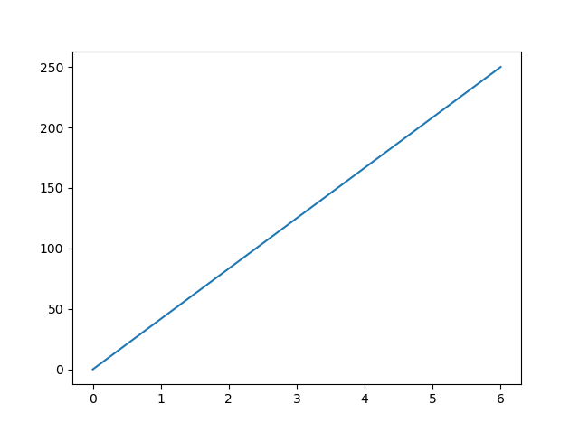
Drawing a chart – example 1
import matplotlib.pyplot as plt import numpy as np xpoints = np.array([0, 6])
ypoints = np.array([0, 250]) plt.plot(xpoints, ypoints) plt.show()

Slide 8
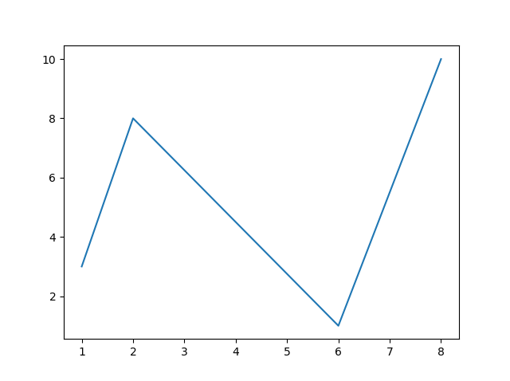
Drawing a chart – example 2
import matplotlib.pyplot as plt import numpy as np xpoints = np.array([1, 2, 6, 8])
ypoints = np.array([3, 8, 1, 10]) plt.plot(xpoints, ypoints) plt.plot(xpoints, ypoints)

Slide 9
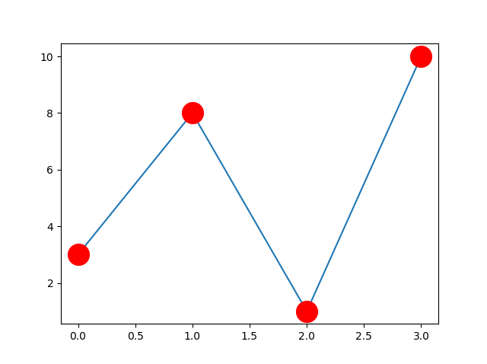
Drawing a chart – example 3
import matplotlib.pyplot as plt import numpy as np ypoints = np.array([3, 8, 1, 10]) plt.plot(ypoints, marker = 'o', ms = 20, mec = 'r', mfc = 'r’)
plt.show()

Slide 10
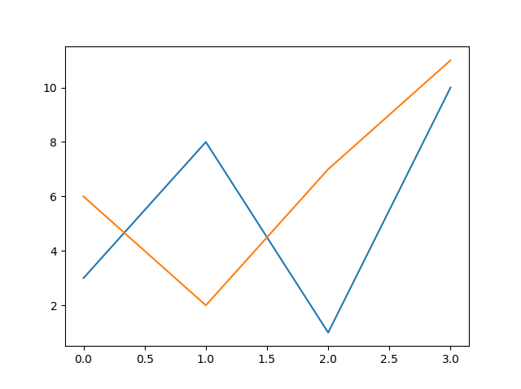
Drawing a chart – example 4
import matplotlib.pyplot as plt import numpy as np y1 = np.array([3, 8, 1, 10]) y2 = np.array([6, 2, 7, 11]) plt.plot(y1) plt.plot(y2) plt.show()

Slide 11
Drawing a chart – example 5
import matplotlib.pyplot as plt import numpy as np x1 = np.array([0, 1, 2, 3]) y1 = np.array([3, 8, 1, 10])
x2 = np.array([0, 1, 2, 3]) y2 = np.array([6, 2, 7, 11]) plt.plot(x1, y1, x2, y2) plt.show()

Slide 12
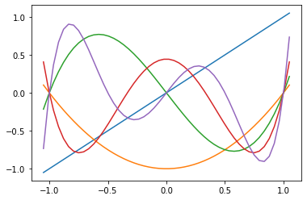
Drawing a chart – example 6

Slide 13
Now you do it
Start Anaconda
Start Jupyter
Create a notebook and save it
Create and plot the above charts

Slide 14
Building plots in a Jupyter notebook
Start Anaconda
Start Jupyter
Create a notebook and save it
Create and plot the above charts

Slide 15
Assignment - Review

Slide 16
Assignments – feedback & advice
An apology – the Python string escape sequence for a carriage return is not ‘\cr’ it is ‘\r’ (see https://docs.python.org/3/reference/lexical_analysis.html#strings)
Take a little more time to design your code before rushing to the computer to write it
Keep expressions simple, especially so with Boolean expressions and iterations
Execute statements in the IDLE shell to confirm your logic
Test your code

Slide 17
Design before build
Make sure you understand the problem
Look at the big picture, try not to get trapped in the details
How would you solve this problem with paper & pencil
Can you describe the algorithm (the process or recipe) for solving this problem to another person
Outline the procedure with pseudocode
Desk-check your pseudocode
Write the code

Slide 18
Keep expressions simple - assignments
Python allows expressions such as a=b=c=d=X but be careful.
a=b=c=d=6 and a=b=c=d=‘six’ work as you might expect
w=x=y=z=[6] does not!
Run a=b=c=d=6 in interactive Python and then display the values with a,b,c,d
Then execute b=7 and display the values of a,b,c,d again
Run w=x=y=z=[6] in interactive Python and then w,x,y,z
Then execute x.append(7) and display the values of w,x,y,z again
Explain?

Slide 19
Keep expressions simple - Booleans
6 == 6 == 6 ⇨ True
(6 == 6) == 6 ⇨ False
6 == 6 == 6 * 2 ⇨ False
(6 == 6 == 6) * 2 ⇨ 2
6 == (6 == 6) * 2 ⇨ False
(6 == (6 == 6)) * 2 ⇨ 0
# and more complexity with <, <=, !=, >=, >
# safest to keep it simple and combine with and, or and not

Slide 20
Test your code with ‘assert’ statements
assert score_4(1, 5, 6, 6) == 7 assert score_4(3, 2, 3, 3) == 2 assert score_4(2, 6, 1, 5) == 14 assert score_4(1, 1, 2, 6) == 7 assert score_4(1, 2, 3, 4) == 1 assert score_4(3, 3, 3, 4) == 7 assert score_4(3, 3, 4, 4) == 21 assert score_4(4, 3, 3, 4) == 21
# if the expression is true NOTHING happens

Slide 21
Part 1 or final assignment due on Sunday
Post on forum or email

Slide 22
Many types of Charts
Some examples:

Slide 23
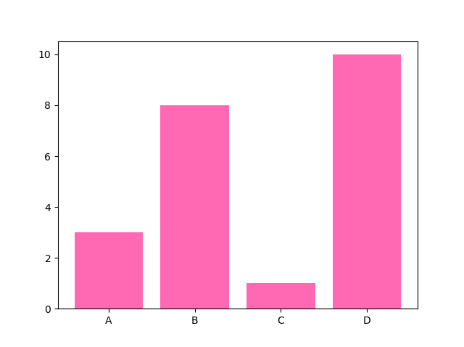
Bar Chart
import matplotlib.pyplot as plt import numpy as np x = np.array(["A", "B", "C", "D"]) y = np.array([3, 8, 1, 10]) plt.bar(x, y, color = "hotpink") plt.show()

Slide 24
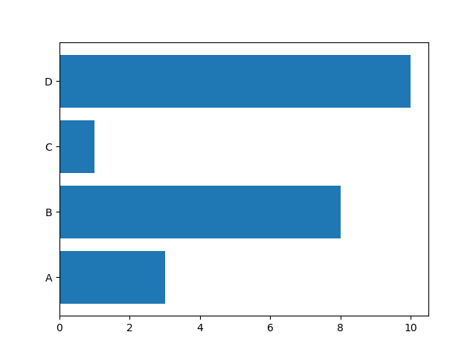
Horizontal Bar Chart
import matplotlib.pyplot as plt import numpy as np x = np.array(["A", "B", "C", "D"]) y = np.array([3, 8, 1, 10]) plt.barh(x, y) plt.show()

Slide 25
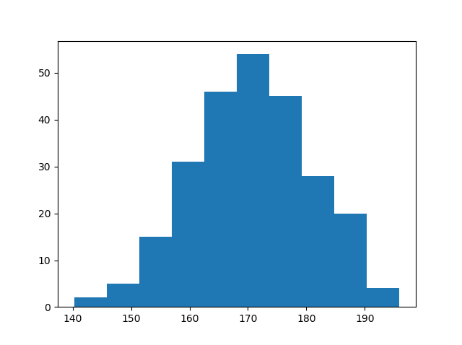
Histograms
import matplotlib.pyplot as plt import numpy as np
# generate 250 random data points
# normally distributed around 170
# with a SD of 10
x = np.random.normal(170, 10, 250) plt.hist(x) plt.show()

Slide 26
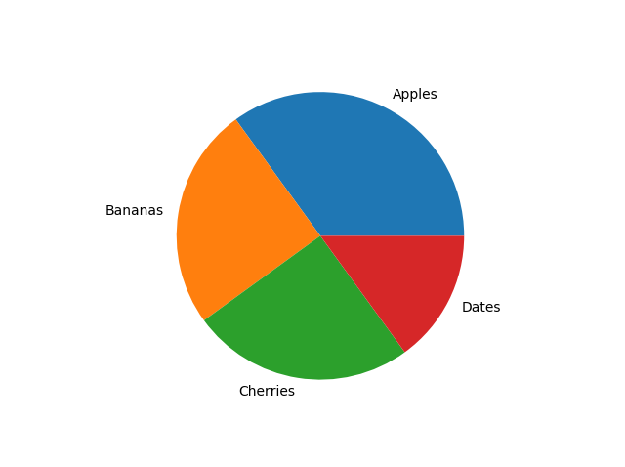
Pie Chart
import matplotlib.pyplot as plt import numpy as np y = np.array([35, 25, 25, 15]) mylabels = ["Apples", "Bananas", "Cherries", "Dates"] plt.pie(y, labels = mylabels) plt.show()

Slide 27
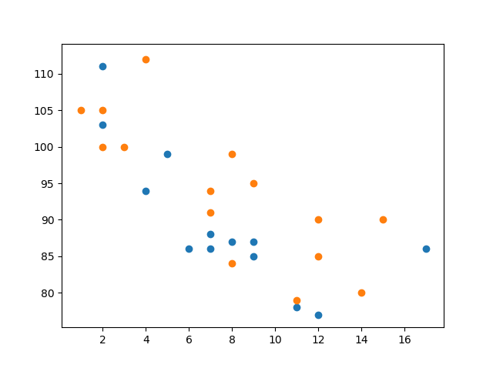
Scatter Plot
import matplotlib.pyplot as plt import numpy as np #day one, the age and speed of 13 cars: x = np.array( [5,7,8,7,2,17,2,9,4,11,12,9,6]) y = np.array( [99,86,87,88,111,86,103,87,94,78,77,85,86]) plt.scatter(x, y) #day two, the age and speed of 15 cars: x = np.array( [2,2,8,1,15,8,12,9,7,3,11,4,7,14,12]) y = np.array( [100,105,84,105,90,99,90,95,94,100,79,112,91,80,85]) plt.scatter(x, y) plt.show()

Slide 28
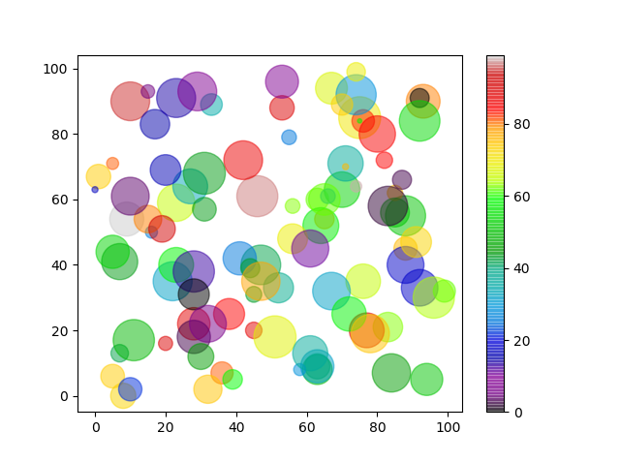
Scatter Plot
import matplotlib.pyplot as plt import numpy as np x = np.random.randint(100, size=(100)) y = np.random.randint(100, size=(100)) colors = np.random.randint(100, size=(100)) sizes = 10 * np.random.randint(100, size=(100)) plt.scatter(x, y, c=colors, s=sizes, alpha=0.5, cmap='nipy_spectral') plt.colorbar() plt.show()

Slide 29
Styling Charts points, lines, axes, titles

Slide 30
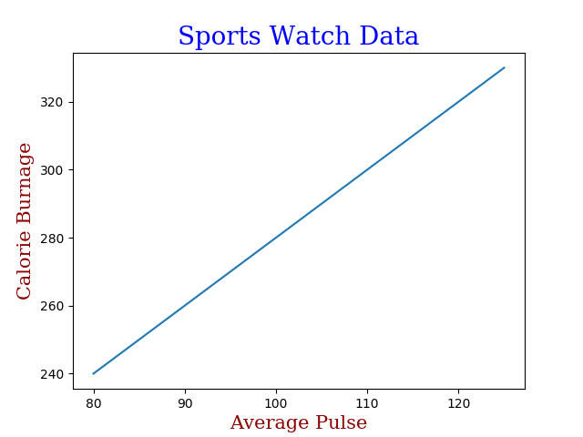
Styling a chart - labelling
import numpy as np import matplotlib.pyplot as plt x = np.array([80, 85, 90, 95, 100, 105, 110, 115, 120, 125]) y = np.array([240, 250, 260, 270, 280, 290, 300, 310, 320, 330]) font1 = {'family':'serif','color':'blue','size':20} font2 = {'family':'serif','color':'darkred','size':15} plt.title("Sports Watch Data", fontdict = font1) plt.xlabel("Average Pulse", fontdict = font2) plt.ylabel("Calorie Burnage", fontdict = font2) plt.plot(x, y) plt.show()

Slide 31
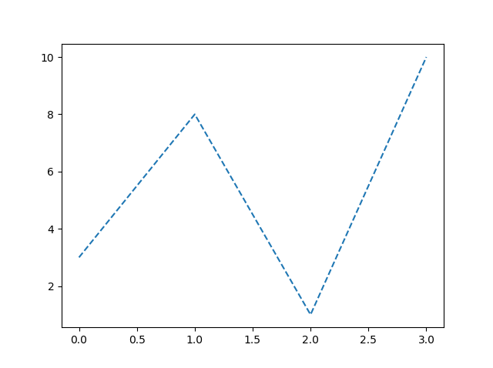
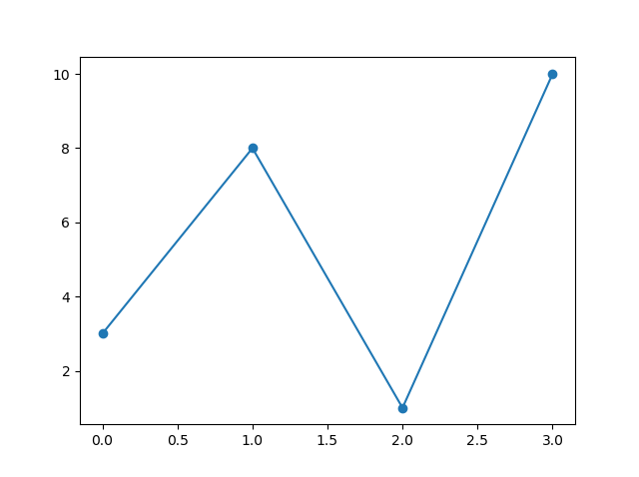
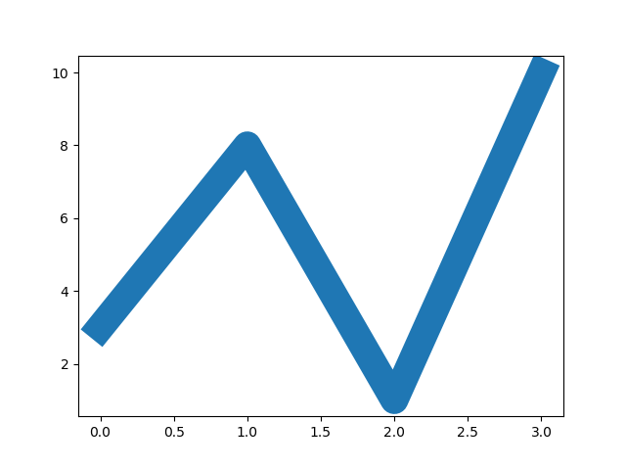
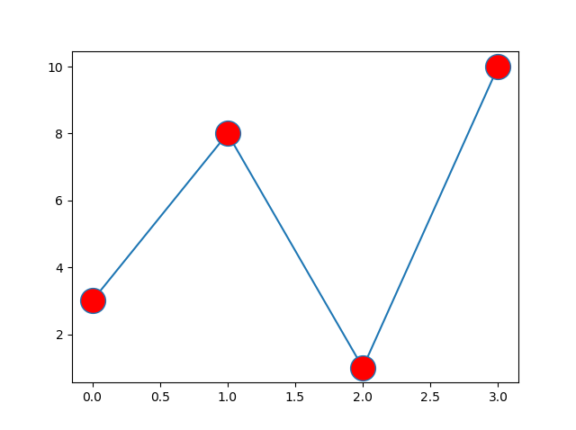
Lines
Points

Slide 32
Example Applications

Slide 33
Ten Simple Rules for charting
Know Your Audience
Identify Your Message
Adapt the Figure
Captions Are Not Optional
Do Not Trust the Defaults
Use Colour Effectively
Do Not Mislead the Reader
Avoid “Chartjunk”
Message Trumps Beauty
Get the Right Tool

Slide 34
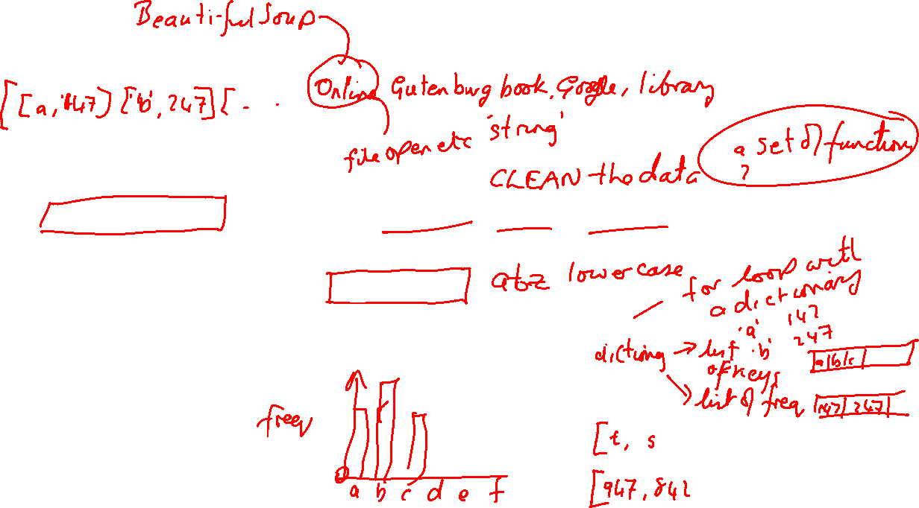
1 - Character Frequency Analysis of a text
Find a suitable source of text
Read the text into Python
Clean the data. Maybe it has headers, footers, page numbers, ISBN information, publication dates, etc,. Remove them.
Decide what counts as a character.
Count the number of occurrences of every character
Transform that information into a numpy array
Display using Matplotlib

Slide 35
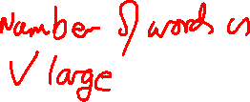
2 - Word Frequency Analysis of a text
Find a suitable source of text
Read the text into Python
Clean the data. Maybe it has headers, footers, page numbers, ISBN information, publication dates, etc,. Remove them.
Decide what counts as a word.
Count the number of occurrences of every word
Transform that information into a numpy array
Display using Matplotlib ???

Slide 36
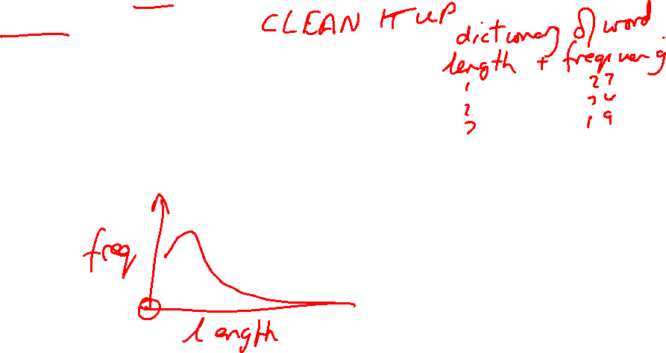
3 - Word Frequency-Length Analysis
Find a suitable source of text, read it into Python and clean it up
Decide what counts as a word.
Count the number of occurrences of every word
Measure the length of every word
Transform that information into a numpy array suitable for charting
Display using Matplotlib

